Slide 1
Design Patterns

Slide 2
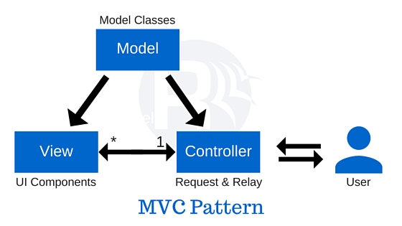
MVC

Slide 3
MVC
Model data access operations
View interface
Controller process incoming requests user data through model passing back results to view

Slide 4
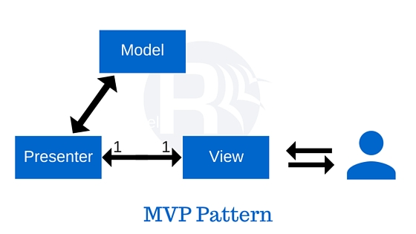
MVP

Slide 5
MVP
Model data access operations
View interface
Presenter receive incoming requests from view user data through model passing back results to view view and model are completly separated

Slide 6
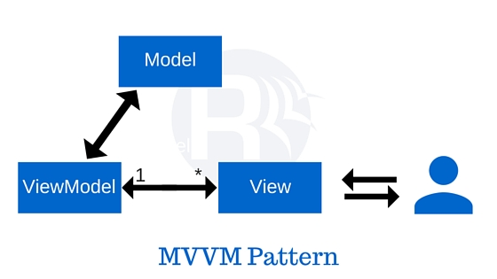
MVVM

Slide 7
MVVM
Model data access operations
View interface
ViewModel responsible for displaying methods manipulating model as action of view trigger events in view

